Slide 1
GREATER LONDON AUTHORITY & Partners Indoor and Outdoor Cool Spaces 1June - 15 September 2022 FREQUENTLY ASKED QUESTIONS
FOR THOSE INVITED TO REGISTER SITES

Slide 2
What is a Cool Space?
Cool Spaces are public or private spaces within a city, which are open to the public; and designed to provide residents in a borough, including those with no fixed abode and those who don’t have the adaptive cooling facilities in their homes, with temporary respite from high temperatures.
Cool Spaces will be designated by boroughs, community groups, faith- based organisations and other organisations based on predetermined criteria,( established following consultation on the criteria with a diverse group of stakeholders) and can include outdoor areas or parts of buildings open to the public during designated heat emergencies.
This summer, as with last summer, the Greater London Authority’s (GLA) together with partners is seeking to establish a network of cool spaces across the city that is accessible to all Londoners. During summer heatwaves, there is a need for spaces in the city where members of the public can rest from the heat and cool down.
The idea of a cool space is to complement the guidance in the UK Health Security Agency and NHS England Heatwave Plan for England. Whilst the Heatwave Plan encourages people to stay at home during a heatwave, there will be Londoners who are caught up outside in the city during heatwaves, whilst going about their day-to-day lives. The cool spaces are designed to provide a short period of retreat during these times.
Certain groups have specific medical advice to take during heatwaves. This initiative is not intended to replace any medical advice, and if people are unsure, they should consult their GP/ a medical professional.

Slide 3
How Should a Cool Space be Selected?
Cool Spaces are proposed to the GLA by boroughs and other organisations – the Cool Space Providers – through a registration process, and later selected by the GLA.
Cool spaces may include both outdoor spaces and spaces within buildings. They could include shaded open spaces ( for example, parks, green spaces etc), cultural institutions ( for example, museums, theatres, etc.), libraries, places of worship, community centres, recreational and civic amenities such as gyms, health services, shops, among others.
Organisations which are interested in hosting one or more cool space/s should fill in an online application form during the registration period which ends on 30th April,2021.
The questions in the form were designed by the GLA and partners to address a set of characteristics that make an indoor or outdoor site appropriate to be used as a cool space.
The information submitted by cool space providers will be used by the Cool Spaces Project Steering Group to designate a network of London cool spaces. This network will include a tiered system of cool spaces with different types and characteristics. The designation will follow criteria developed by the GLA and partners, based on expert advice and international best practice. The criteria will be shared with providers and made available to the public for transparency.

Slide 4
When should they open/Close?
The places must be willing to be promoted as a ‘Cool Space’, opened during the period that the UK Health Security Agency and NHS England Heatwave Plan for England is in operation from (1st to June -15th September, annually),.
The Mayor’s Hot Weather Alerts’ protocol is issued when heatwave levels 2/3 are triggered as defined in the NHS Heatwave Plan. Please go to the link for more information on this:- https://www.gov.uk/government/publications/heatwave-plan-for-england. Expected to be updated for 2022.
The Mayor’s alerts are accompanied by advice on what Londoners can do to protect themselves and those ‘at risk’ during the heatwave period such as by those who are elderly, the very young, those with pre-existing conditions and the homeless. The protocol will include information on where cools spaces can be found.

Slide 5
Where Should they be Located? How Will Londoners know where to find a cool space?
The cool space can be located at any site/building that fulfils the designated criteria. Cool spaces can be indoor and/or outdoor spaces.
Once the registration process is complete, the cool spaces will be shared with the public through an online map.
The map will include other relevant features/information. The full mapped information is still under development but may include location of water fountains and other places where Londoners can refill their water bottles as well as areas with higher heat risk/vulnerability in the city.

Slide 6
What should they provide?
A cool space is expected to open/close during its own planned opening/closing hours. Ideally it would be open from at least 10:00 to 17:00 hours during weekdays, with weekend openings where possible, however, there shouldn’t be any expectations such as the need for extra staff, extended opening hours, resources etc. People using a cool space should be able to spend time at no cost to recuperate from the heat. The GLA will establish a map showing where the cool spaces are located.
Cool spaces, whether indoor or outdoor, should provide cooling during a hot day.
For outdoor cool spaces, shading is an important element. Shading can be natural (e.g. from trees) or from other elements such as umbrellas and should provide shaded cover for most of the day. Shaded seating enables people to sit down and take refuge in an outdoor space during hot weather. The London Tree canopy cover map can be used to provide an indication of the level of natural shading in London’s outdoor areas. Please note that canopy cover does not highlight aspects such as tree maturity, disturbance, pests or disease.
In indoor spaces, cooling can be achieved through natural ventilation or cooling systems such as air conditioning or fans. But the cooling capacity depends on other building characteristics, such as construction materials and exposure to sunlight.
Cool spaces are intended to complement the guidance in the UK Health Security Agency and NHS England Heatwave Plan for England. Whilst the Heatwave Plan encourages people to stay at home during a heatwave, there will be Londoners who are ‘caught up’ in a heatwave on their way to and from a routine medical appointment/work/school/shopping etc. The cool spaces are designed to provide a short period of refuge during these times. Certain groups have specific medical advice to take during heatwaves. This initiative is not intended to replace any medical advice, If people are unsure, they should consult their GP/ a medical professional.
If a person falls ill during the time, they are using the cool space, the response will be the same as would be followed whether the space is designated a cool space or not.

Slide 7
The NHS and Public Health England’s Advice and borough Actions during a Heatwave
Public Health England's advice during a heatwave for people with medical conditions is provided in the UK Health Security Agency and NHS England Heatwave Plan for England :-
https://www.gov.uk/government/publications/heatwave-plan-for-england Expected be updated for 2022.
The Plan also recommends actions that boroughs can take to look after their residents during a heatwave.

Slide 8
REGISTRATION
Registration is open until Friday 30th April 2022 through the following methods: -
Fill in an online form here: https://apps.london.gov.uk/cool-spaces-registration/#/register
Register multiple outdoor public open spaces at once through the Excel form attached (this is a new approach to enable you to register multiple spaces at one time).
Both indoor and outdoor cool spaces will be operational between 1st June - 15th September 2022 (the same period the UK Health Security Agency and NHS England Heatwave plan for England is operational).
Registering multiple sites:
Following requests from some boroughs to provide a less onerous way for submitting multiple sites, we have developed an alternative method for the registration of outdoor public open spaces as cool spaces.
If you would like to register multiple sites, please follow the following 4-step instructions:
1. Open the attached Excel spreadsheet
2. Answer the 2 Preliminary Questions and read the instructions on
Page 1.
3. On Page 2, find the outdoor public open spaces you would like
to register and fill in the table.
4. When completed please email the spreadsheet to
fireandresilience@london.gov.uk
The closing date for registration is 3rd May 2022

Slide 9
Background and EVIDENCE Of What other Cities are doing through The C40 Cities Cool Cities Network

Slide 10
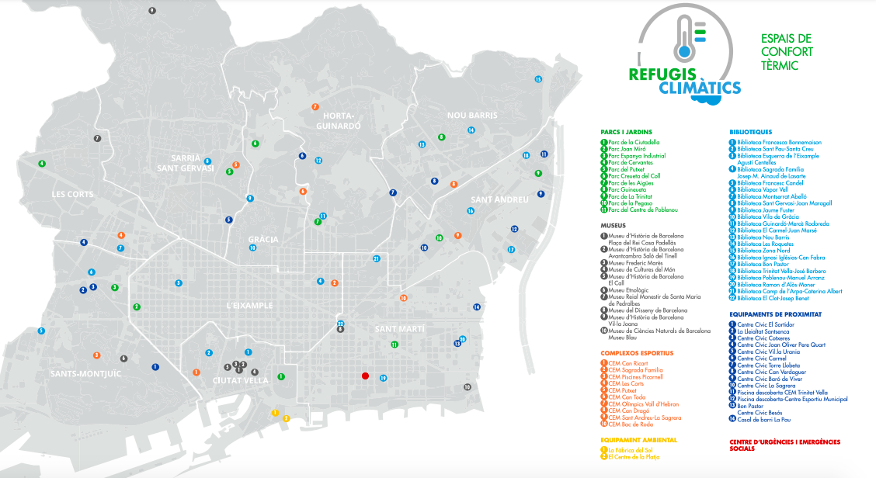
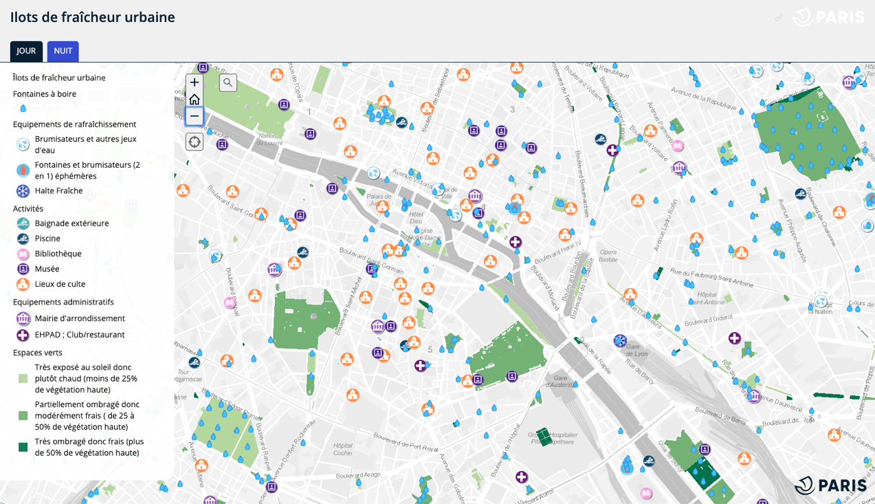
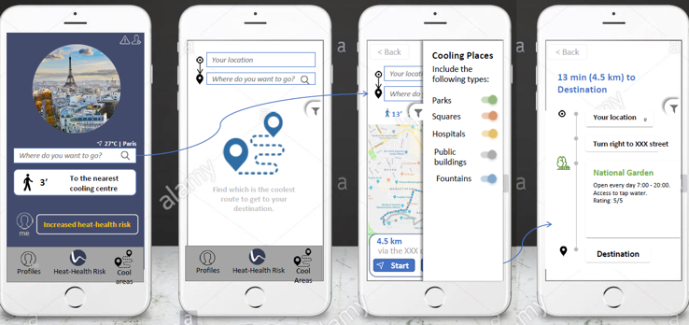
Cool Cities Network
City experiences with cool spaces initiatives
January 2020
Barcelona
The objective of Barcelona’s Climate Plan is that the entire urban population is less than 5 minutes walking distance from a climate shelter, which are open spaces (parks and gardens with certain dimensions, with vegetation and water points), public buildings (civic centres, libraries, sports centres, museums, etc.) and private venues (shopping centres, cinemas , theatres, etc.).
In the 2020 summer, the City has launched 70 facilities as climate shelters.
https://capgeo.sig.paris.fr/Apps/IlotsFraicheurUrbaine/
https://www.barcelona.cat/barcelona-pel-clima/sites/default/files/parcs_refugis_climaitics_estiu_2020-2.pdf
Paris
There are nearly 1000 cool islands (îlots de fraicheur) in Paris, which include outdoor swimming pools, libraries, museums, places of worship, borough halls, green spaces, drinking fountains, water fountains etc.
Two maps show the location of the cool islands that are open during the day, and also during the night. The City also launched a mobile application called EXTREMA, where the cool islands are listed and can easily be found by users. The app also calculates the shortest and the coolest route from any point A to any point B in Paris. Users can rate each cool island, e.g. user can say if it was easy to find the cool island, if it provided heat relief etc.
https://www.paris.fr/pages/la-canicule-5469
https://play.google.com/store/apps/details?id=com.phonegap.extremaparis

Slide 11
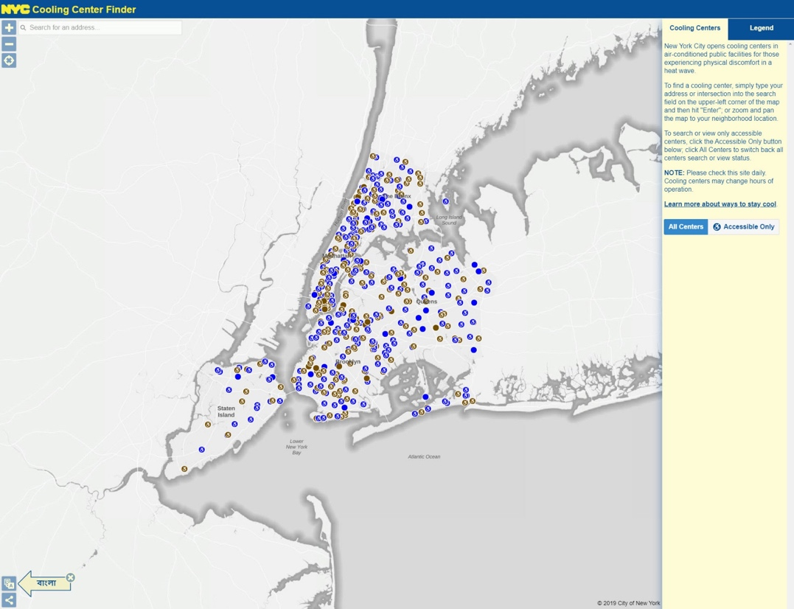
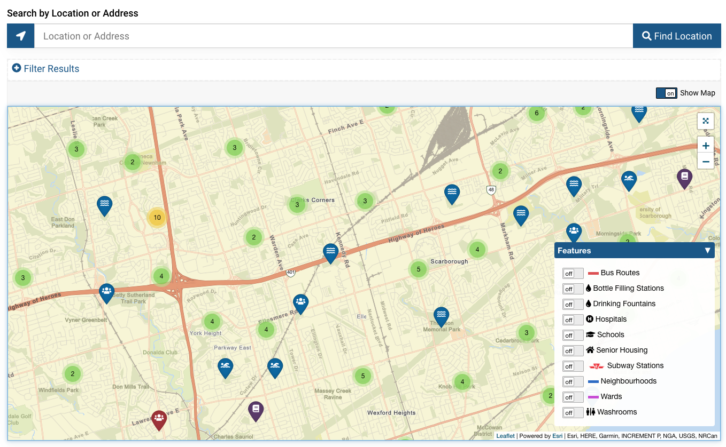
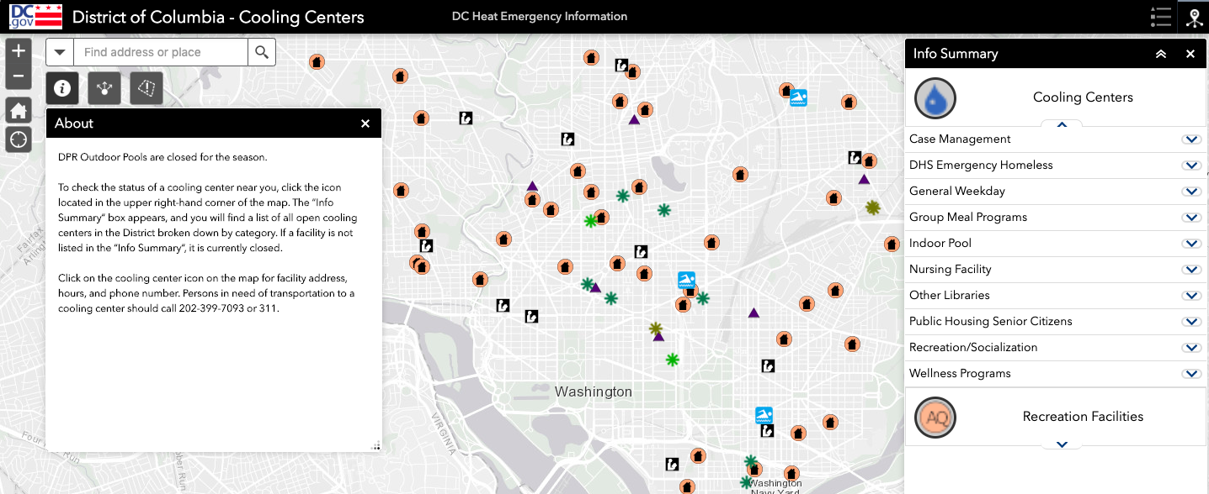
Cool Cities Network
January 2020
New York City
NYC has approximately 500 cooling centres (air conditioned facilities) that are co-located in existing facilities such as public libraries, senior centres, and community centres open to the public.
The City opens cooling centres when weather forecasts predict Heat Indices (HI) of 100 F (38°C) for any one day or HI of 95F (35°C) or higher for 2 or more days or both.
To communicate this information, the City uses press releases, social media, Notify NYC alters and an online Cooling Centre Finder.
https://maps.nyc.gov/oem/cc/
https://www1.nyc.gov/site/em/ready/extreme-heat.page
Toronto
Toronto’s Heat Relief Network of more than 300 cool spaces across the city includes libraries, community centres and pools, some Civic Centres and City facilities, drop-ins, and several private and non-profit organizations, including some shopping malls and YMCA locations. The network also includes shelters and 24-Hour Respite Centres that are available for individuals experiencing homelessness.
The Heat Relief Network locations are searchable through an online platform.
→ https://www.toronto.ca/community-people/health-wellness-care/health-programs-advice/hot-weather/cool-spaces-near-you/#location=&lat=43.770412&lng=-79.278030
Washington DC
Washington DC has a network of cooling centres that are opened during heat emergencies (defined here as heat index above 95 degrees F). Cooling centres include libraries, pools, splash pads, senior citizen centres, recreation centres, and homeless centres. During heat emergencies hours are extended at designated cooling centres.
→https://dcgis.maps.arcgis.com/apps/webappviewer/index.html?id=c975110d05a24acba55f65eef283e05b

