Slide 1
The Parish Support Fund
PCC presentation for 2027 pledges

Slide 2
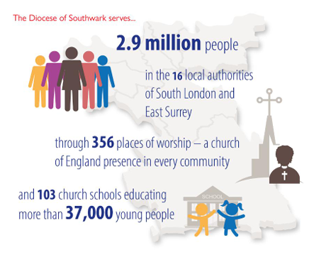
Thank you for your generous commitment to the Parish Support Fund (PSF), our parish share system, helping fund mission and ministry across Southwark diocese.
Notes:
The Diocese seeks to be a Christian presence and to share the Christian faith in each of its parishes through the mission and ministry of its clergy, congregations, schools and chaplaincies and works to promote the common good, with a particular concern for those most in need.

Slide 3
What is the Parish Support Fund?
The Parish Support Fund (PSF0 is our parish share system
Rather than each church paying for its own vicar and other costs of ministry, we pool our resources with richer parishes supporting poorer ones. This means we can put clergy in the places where they are needed most
The PSF is a generosity-based pledge scheme which brings together the principles of proportionality, informed generosity and an aspiration towards becoming self-financing
Every parish pledge is vital – as the writer to the Hebrews reminds us “do not forget to do good and to share with others, for with such sacrifices God is pleased.”
.

Slide 4
Where does Diocesan income come from?
Dioceses, like parishes, are independent charities, distinct from the Archbishops’ Council and Church Commissioners BUT we are all part of the Anglican family/communion
Neither the government nor the Church Commissioners pay for our parish clergy or any of our shared costs of ministry
Southwark Diocese’s 2025 income was from
  Parish Support Fund, our parish share system, £16.4m in 2025, 2026 budget £16.65m
  Parochial fees - £0.35m
  Grants/funding from outside the Diocese, mostly restricted, some decreasing - £4.9m
  Other income e.g. investment income, property, reimbursement of stipends - £3m
  Sale of assets ie property and use of reserves £5.3m
  Big challenge: The gap has widened between PSF requests and pledge offers. In 2026 we had a 3.2% gap between what we asked for and what we received

Slide 5
Tricky Financial challenges for everyone
We acknowledge that our Churches and congregations are facing pressures around buildings, rising utility costs, availability of volunteers, how to fund worship and, where needed, staff costs
Since 2019
  inflation has risen by 31%
  The diocese has managed costs carefully – shared costs of ministry risen by just over half that amount
  BUT Parish Support Fund income risen by 3.1% with the diocese using general reserves to cover operational deficits
  Diocesan Free reserves are £1.5m at 31.12.25 – less than some parishes
.

Slide 6
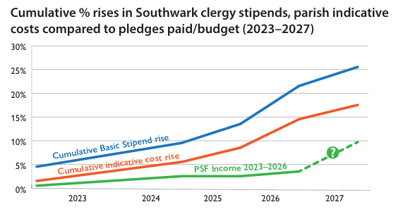

Slide 7
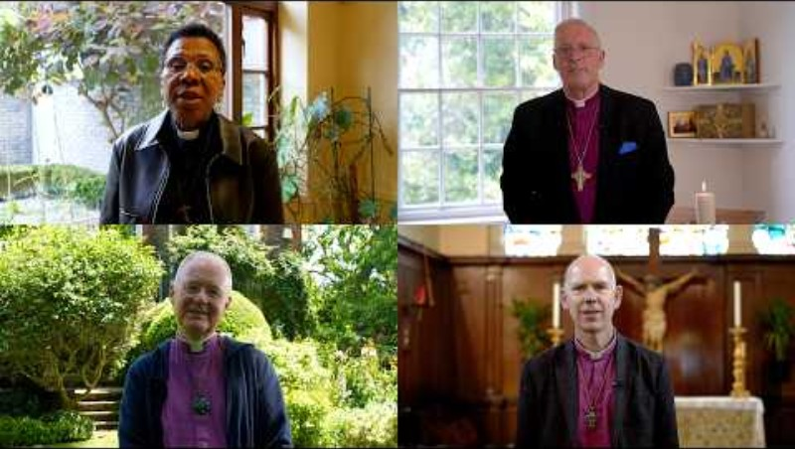
A message from our Bishops (internet needed to play)
https://youtu.be/LfG3vTZc144

Slide 8
Journeying onwards
We are now faced with new and substantial challenges of how to resource parishes and maintain the number of clergy
As you may be aware we are undertaking a strategic review of all areas of expenditure, including clergy posts and diocesan staffing.
Asking parishes to consider a generous PSF pledge this year, to help us address our predicted deficit of nearly £1m for 2027
“We want to be transparent with you that this level of funding and falling diocesan reserves are insufficient to sustain current levels of ministry.
(Bishop Rosemarie and Nicola, our Diocesan Secretary)

Slide 9
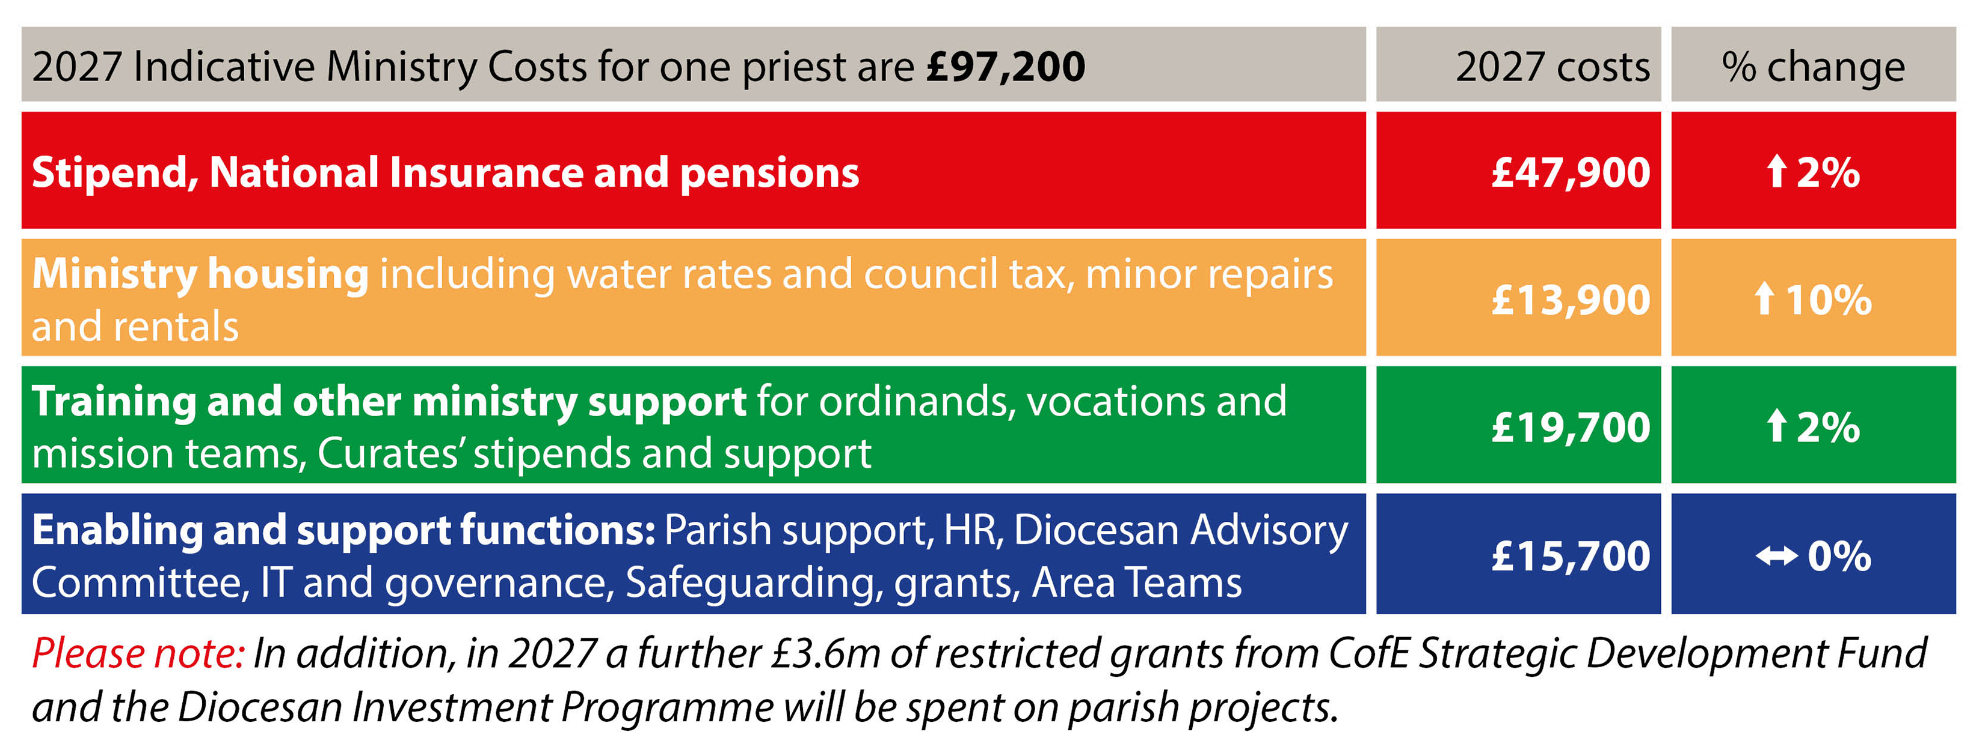
Understanding our shared costs of ministry
Our indicative costs of ministry show what is budgeted in 2027 for the direct costs of parish clergy ie stipends, NI and pension and the average costs of housing provision, training of future clergy and parish support teams
Notes:
Our indicative costs of ministry show what is budgeted in 2027 for the direct costs of parish clergy ie stipends, NI and pension and the average costs of housing provision, training of future clergy and parish support teams

Slide 10


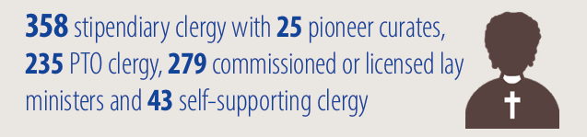
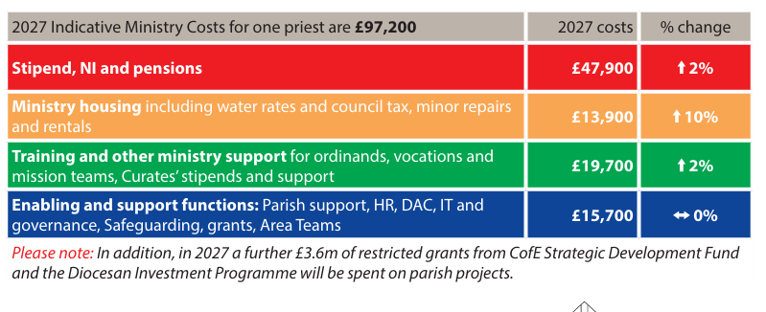
Clergy stipends, NI and pensions
Stipends, National insurance and pension costs total £47,900 per priest for 2027, and 50% of total costs - the diocese’s major cost and investment
Synod approved the 10.3% stipend increase for 2026/27. The National church has yet to announce the recommended Stipend for 2027/28, but it is linked to Consumer Prices Index including Housing costs (CPIH) and likely to be 3% or above
Our Dean of Clergy Wellbeing continued to be available to all clergy, referring them and their families to appropriate therapy and sources of support. A new wellbeing peer-support programme for clergy – nine in twelve – was hugely successful and will run again in 2026.
Christ Centred | Outward Focused

Slide 11

Providing clergy with housing
Property costs include smaller repairs and maintenance, payment of water rates, council tax and insurance on more than 250 clergy properties; plus rental of properties, when required
In 2025 the team arranged 2,224 repairs to properties at a cost of over £1.4m and completed more extensive work for 34 parishes in vacancy at a cost of over £1.7m
Housing costs have risen by 10% year on year and represent 14% of our parish indicative costs of ministry
The Property Team work hard to support parish ministry through ensuring that clergy and their families have suitable, comfortable accommodation
The team aims to deliver sustainable and cost-effective work, aligning our property use with our Southwark diocesan Vision
Christ Centred | Outward Focused

Slide 12

Training and other ministry support
Vocations and Clergy Formation Team supported 28 ordinands in training, as well as 65 curates and their training incumbents. 2025 cohort for the Bishop’s Certificate was our biggest and most diverse ever, with 87 students taking part
36 people trained on the Children and Young People Catalyst course
Dean of Revitalisation supported 83 parishes through Mission Action Planning training
Training and other ministry support amounts to £19,700 for 2027, is 20% of total indicative costs and increased by 2% on 2026 costs.
Includes vocations support, curates’ stipends, national and diocesan training and development for lay and clergy - including our National Ministry Fund payment to cover ordinands’ tuition fees - living and travel expenses
Mission team including Mission Action Planning, Children and Young People’s team, Fresh Expressions and Pioneering encouraging FxC, Hub and Resourcing Churches.
Christ Centred | Outward Focused

Slide 13

Enabling & support functions for parishes
136 parish proposals for church buildings recommended
More than 1,500 people completed at least one of our safeguarding courses
At least 169 separate enquiries, with parishes seeking advice about a variety of employment matters with our HR team
Includes Safeguarding – parish Disclosure and Barring (DBS) applications, training and casework
Area teams i.e. Archdeacons and their offices
Parish support such as HR advice, Governance, Finance and Diocesan Advisory Committee (DAC) i.e. Church buildings advice
Grants to Welcare & Board of Education
Contributions to National Church were reduced in 2026
Christ Centred | Outward Focused
Notes:
Human Resources Team worked to equip parishes for mission and ministry through providing HR support on a range of employment matters and supporting the resolution of local staffing challenges. There were at least 169 separate enquiries, with parishes seeking advice about a variety of employment matters, ranging from the provision of templates and telephone advice, to cases requiring more extensive support about employment matters. There were 14 cases requiring more intensive longer-term support and advice for parishes, ranging from restructures and redundancies to performance issues, and matters of serious misconduct.

Slide 14
What your PSF pledge does not pay for
Bishops: the Church Commissioners pay for Diocesan and Area Bishops
Some Diocesan posts are time-limited and are fully or part-funded from grants e.g. Net Zero Carbon, Racial Justice, DIP Project posts. (In 2025 40.5 FTE posts were national funded fixed term posts in parishes/diocese)
Specific projects where we have secured funding e.g. Diocesan Investment Programme/Strategic Development Projects e.g YMIC, Bubble Church
Where costs are covered by the National Church’s grants e.g. Building for Mission grants
Contribution to property costs for non-parish ministry properties and major repairs to parsonage properties
The Cathedral is responsible for its own costs and makes a pledge to the PSF

Slide 15
“Your generous giving could make a big difference! ”
“The gap has widened between PSF requests and pledge offers. In 2026 we had a 3.2% gap between what we asked for and what we received. We have controlled costs so that the cost of supporting one priest in one parish has risen by only 3% this year. Please aim to offer an increase above 3%. We need a 7.5% increase in PSF giving in 2027 to break even. Your generous giving could make a big difference!”
(Bishop Rosemarie & Nicola, our Diocesan Secretary)

Slide 16
Questions for your PCC to consider
Would we like more information – should we attend one of the Archdeacons’ Question and Answer sessions? (See Southwark Diocesan website PSF page)
Have we considered the specific request for the increase in our pledge in our parish email, and are we doing our utmost to fund the cost of ministry in our parish and support future ministry across the diocese?
Is our pledge realistic and generous, in proportion to our resources and supportive of our diocesan family?
Please prayerfully reflect on your pledge and make a generous and realistic offer. Please submit your pledge online by 15 September. Thank you

Slide 17
Prayer
Thank you for all the people and churches who contribute to the Parish Support Fund.
Let us give thanks to God for all that has been made possible through it over the years.
May God’s love will be poured into our hearts through the Holy Spirit, that we may face our financial challenges with generosity and courage, seeking in all things to be Christ Centred and Outward Focused and to serve our diverse communities across South London and East Surrey.
Amen

