Slide 1


Looking for a new Bishop of Southwark
March 2026

Slide 2
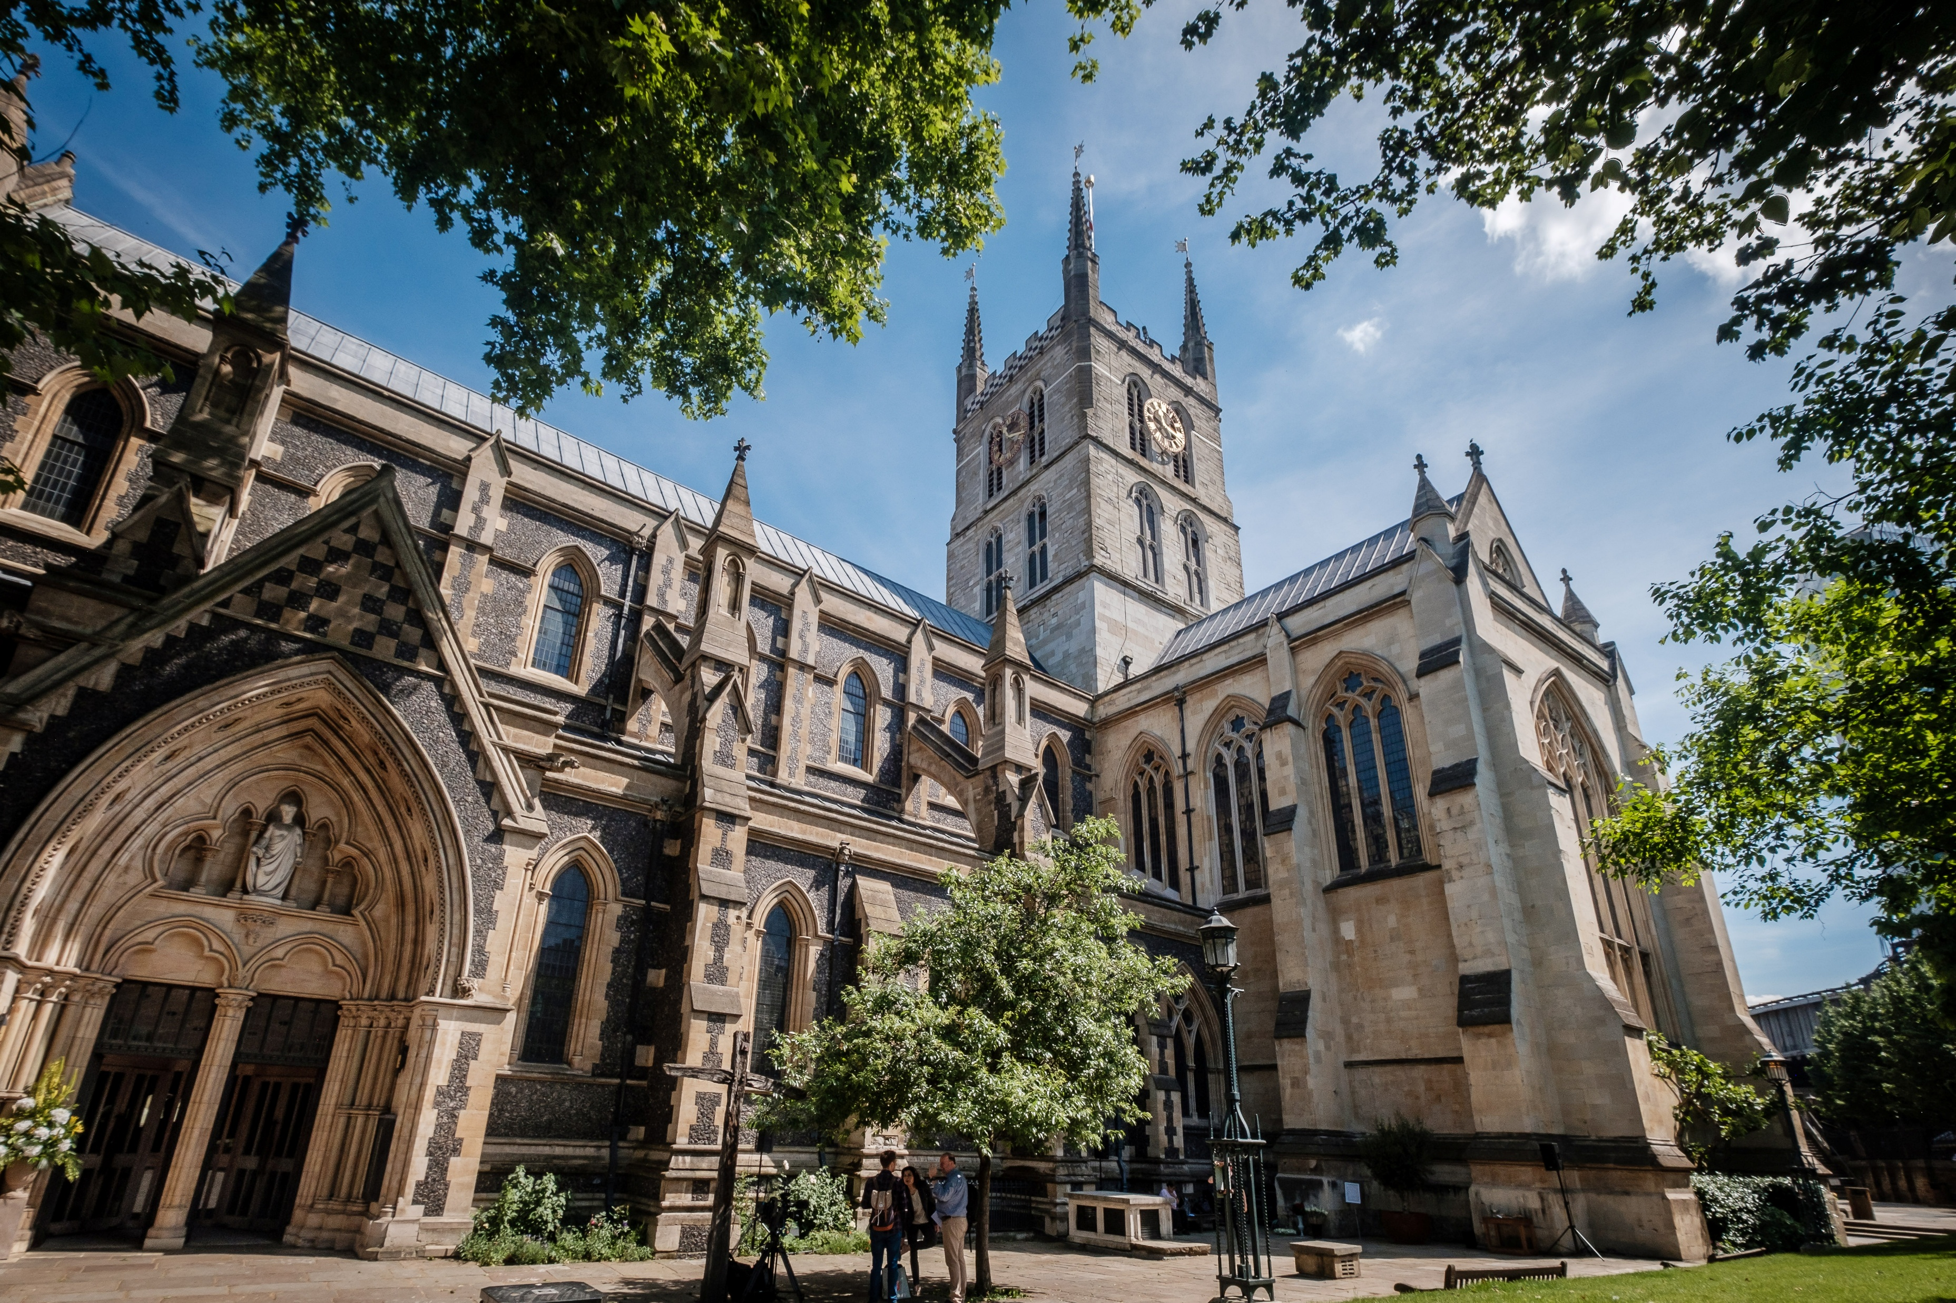
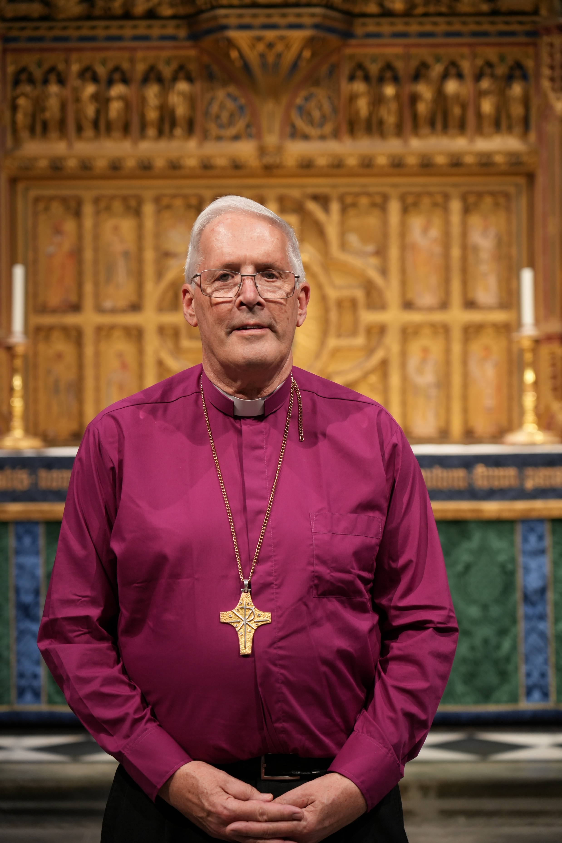
Southwark Cathedral
Bishop of Southwark
Christopher Chessun

Slide 3
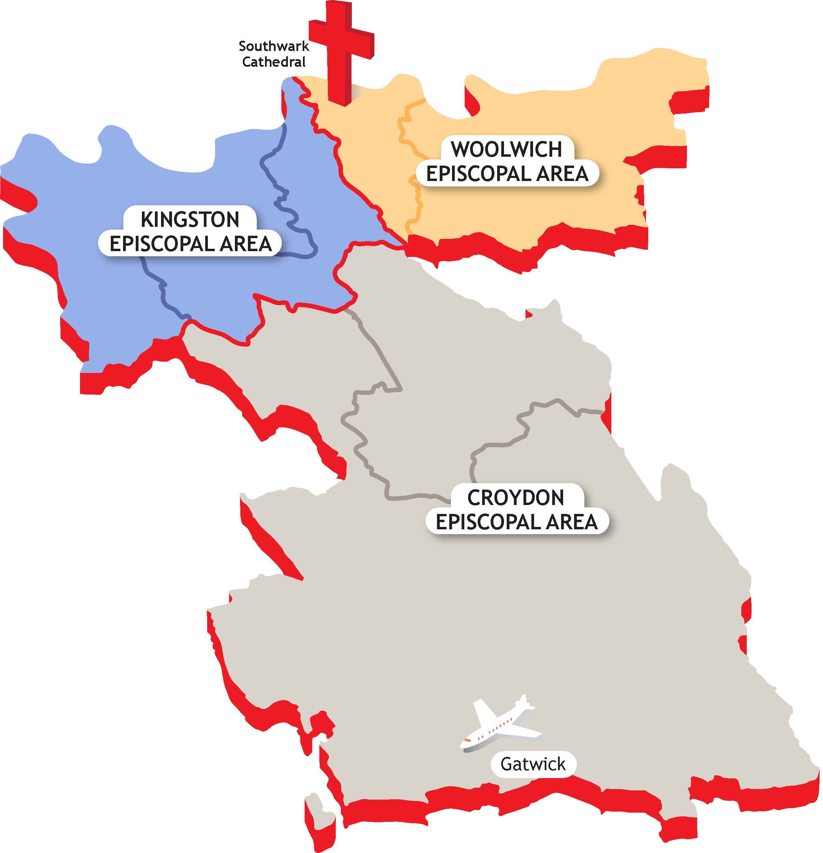
Map of Southwark Diocese

Slide 4
What's on Your Head? –
Series 1: 7. Bishop Mitre - BBC iPlayer

Slide 5
Looking for the next Bishop of Southwark
The next Bishop of Southwark will be a leader in the places where we live, learn and play. I wonder what kind of leader you would like to see?
What do you hope your new Bishop will be like?
What do you think will be the most difficult thing they have to do?
What do you think their most important first jobs might be?
Is there anything else that you think is important for the people making decisions about this to know?

Slide 6

Thank you!
Your thoughts & ideas will help us choose
the next Bishop of Southwark.

Slide 7
Prayer
Dear God,
Thank you for loving our diocese and everyone in it.
Please help us while we look for a new Bishop.
Show us the right person who will listen to you,
care for people and help us follow Jesus every day.
We pray for Bishop Christopher as he gets ready to retire.
Thank you for all the ways he has helped us.
Please give him rest, happiness, and lots of your peace.
Help all the people making big decisions.
Help our churches, schools, and families
to pray and listen to you.
And help us to trust that you are with us
and will guide us.
Amen.

