Slide 1
The Parish Support Fund
PCC presentation for 2026 pledges

Slide 2
“2025 marks the ten-year anniversary of our Parish Support Fund (PSF). This anniversary offers an opportunity for reflection on all that the PSF has enabled over the last decade – as well as enormous gratitude for all that’s been given and for God’s faithfulness to us over these years .”
Bishop Christopher
Bishop Rosemarie: “Thank you for ten years of amazing generosity in the face of enormous challenges.”
Bishop Martin: “Thank you for ten years of faithfulness to God’s calling.”
Bishop Alastair: “Thank you for ten years of going the extra mile – not just financially, but in all that you give to bless and serve communities across South London and East Surrey.”

Slide 3

Ten years of generosity – thank you!
Between 2016–2024 parishes have given £145.2m in pledges through the PSF with 71%/£104m spent on clergy stipends, NI and pension. Housing costs totalled a further £36m. The remaining other ministry and enabling functions costs needed to be funded by reserves and other income
22,000+ people were baptised
200+ people have been ordained and trained as curates
20,000 DBS checks processed, help provided with 1300 HR queries and 1730 DAC (church buildings) permissions granted
531 people have participated in the Bishop’s Certificate
But in real terms PSF pledges have not kept pace with inflation, despite amazing parish generosity

Slide 4
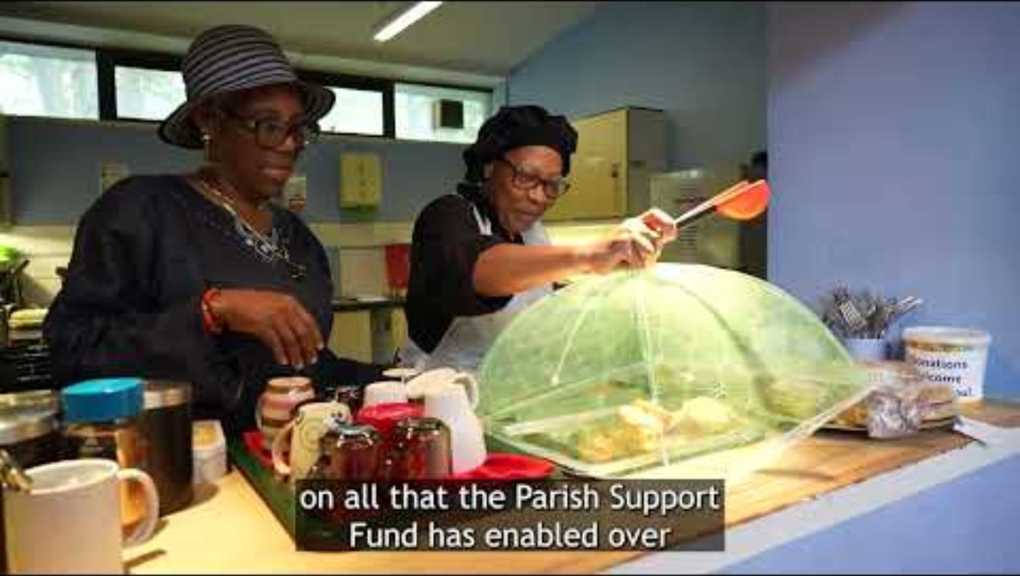
A message from Bishop Christopher (internet needed to play)
https://youtu.be/LfG3vTZc144

Slide 5
Journeying onwards
In order to address clergy wellbeing, the National Church has proposed that dioceses increase clergy stipends to £34,950 in April 2026, a rise of 10.3% for Southwark incumbents
We are now faced with new and substantial challenges of how to resource parishes and maintain the number of clergy
Even with careful management of our diocesan resources and some support from the National Church, our 2026 indicative costs will rise by 5.7%
“I acknowledge that I am asking much of each parish in asking you to prayerfully consider increasing your pledge by 5.7% and enabling our diocese to support parish ministry.”
(Bishop Christopher)

Slide 6


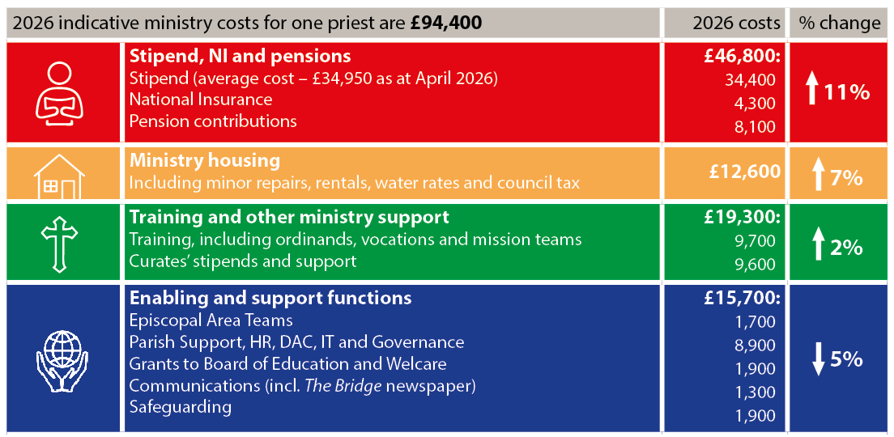
Understanding our shared costs of ministry
All our parishes are invited to make a pledge to the PSF for 2026 to resource our shared gospel ministry
Christ Centred | Outward Focused

Slide 7
Clergy stipends, NI and pensions
Supporting over 350 stipendiary clergy based primarily in parishes.
Stipends, NI and pension costs total £46,800 per priest for 2026, and 50% of total costs - the diocese’s major cost and investment
Stipends include a provisional 10.3% stipend rise for April 2026, as per the National Church’s invitation. (£34,400 is the average stipend in 2026)
Nationally, one fifth of clergy turned to the Clergy Support Trust for additional financial support, so we know clergy wellbeing is a key issue
Pension costs have risen with a calculation change and stipend increase
Christ Centred | Outward Focused

Slide 8

Providing clergy with housing
Property costs include smaller repairs and maintenance, payment of water rates, council tax and insurance on more than 250 clergy properties; plus rental of properties, when required
Housing costs have risen by 7% year on year and represent 13% of our parish indicative costs of ministry
The Property Team work hard to support parish ministry through ensuring that clergy and their families have suitable, comfortable accommodation.
The team aims to deliver sustainable and cost-effective work, aligning our property use with Southwark Vision
Christ Centred | Outward Focused

Slide 9

Training and other ministry support
June and July 2024 saw the ordination of 17 deacons and 21 priests to serve their title posts in Southwark Diocese
69 training curates (18 Pioneer curates) in our parishes during the year – enhancing local mission and ministry as well as nurturing future church leaders
Vocations team worked with over 75 enquirers for both lay and ordained ministry
Training and other ministry support amounts to £19,300 for 2026, is 20% of total indicative costs and increased by 2% on 2025 costs.
Includes vocations support, curates’ stipends, national and diocesan training and development for lay and clergy - including our National Ministry Fund payment to cover ordinands’ tuition fees - living and travel expenses
Christ Centred | Outward Focused

Slide 10

Training and other ministry support cont’d
£220,000 in mission grants given to parishes and individuals
More than 200 people attended CYP conference “Small Changes Big Impact “ in November 2024 - follow-up parish training in 2025
32 people training on our new Estates Lay Pioneer course
Leading Churches into Growth conference planned for 2025
Mission team including Mission Action Planning, Children and Young People’s team, mission grants to churches and individuals
Fresh Expressions and Pioneering encouraging FxC, Hub and Resourcing Churches
Christ Centred | Outward Focused

Slide 11

Wider support for our parishes
More than 1,400 people completed at least one of our safeguarding courses
159 parish proposals for church buildings recommended
90% of churches equipped to use digital giving
Includes Safeguarding – parish Disclosure and Barring (DBS) applications, training and casework
Area teams i.e. Archdeacons and their offices
Parish support such as HR advice, Governance, Finance and Diocesan Advisory Committee (DAC) i.e. Church buildings advice
Grants to Welcare & Board of Education
Contributions to National Church reduced in 2026 due to simplification agenda
Christ Centred | Outward Focused

Slide 12
What your PSF pledge does not pay for
Bishops: the Church Commissioners pay for Diocesan and Area Bishops
Some Diocesan posts are time-limited and are fully or part-funded from grants e.g. Net Zero Carbon, Racial Justice, DIP Project posts
Specific projects where we have secured funding e.g. Diocesan Investment Programme/Strategic Development Projects/Bubble Church
Where costs are covered by the National Church’s grants e.g. Building for Mission grants
Contribution to property costs for non-parish ministry properties and major repairs to parsonage properties
The Cathedral is responsible for its own costs and makes a pledge to the PSF

Slide 13
“We’ve seen the fruits of a decade of incredible generosity by our parishes. As clergy wellbeing and remuneration rightly come evermore into focus, we ask that you prayerfully consider how this might be reflected in your pledge.”
Bishop Alastair
“Every £ of your pledge goes towards supporting ministry in parishes, whether yours or your neighbours”

Slide 14
Three questions for your PCC to consider
Are we doing our utmost to meet Bishop Christopher’s request to increase our pledge to fund the cost of ministry in our parish and support future ministry?
Are we aware that mission in other parts of our diocese is dependent on our giving to the PSF?
Is our pledge realistic and generous, in proportion to our resources and supportive of our diocesan family?
Please prayerfully reflect on your pledge and make a generous and realistic offer. Please submit your pledge online by 15 September. Thank you

Slide 15
Prayer
Loving God,
You created us in your own image and call us to reflect your nature.
Shape our hearts, minds and souls for your service.
Open our eyes to all that you have given,
Open our minds to the possibilities you have set before us,
Open our hands that we might bless others and build your kingdom.
Inspire us with your vision and guide us with your presence,
For the sake of Him who first loved us,
Amen.

