Slide 1
The Parish Support Fund
PCC presentation for 2025 pledges

Slide 2
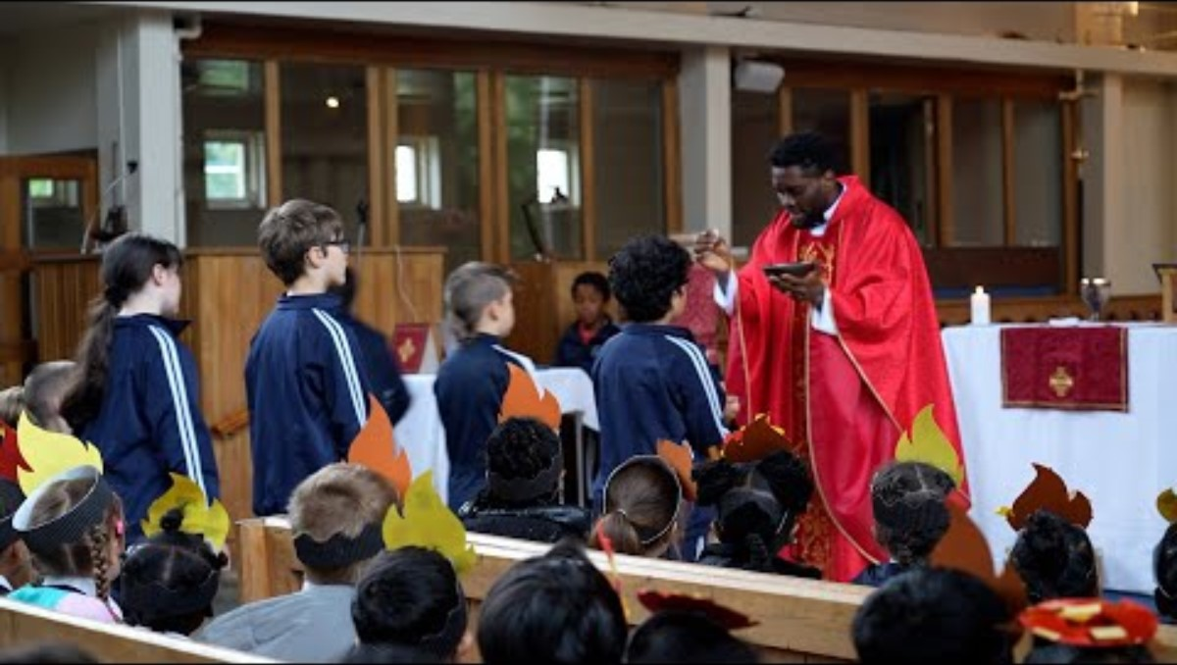
A message from Bishop Christopher (internet needed to play)
https://www.youtube.com/playlist?list=PLIwsBcz8gpIu9ixClHY9RjAmOLb-tMAID

Slide 3
“Each month as I read the finance reports, I give thanks and rejoice in your faithful commitment to the Parish Support Fund (PSF). Thank you to all of you and your PCCs who give generously and work in partnership to support the ministry and mission across our Diocese.”
Bishop Christopher
Thank you for your generosity supporting PSF collection rates of 99% in 2023 and more for 2024 to date
All our parishes are invited to make a pledge to the PSF for 2025 to resource our shared gospel ministry

Slide 4


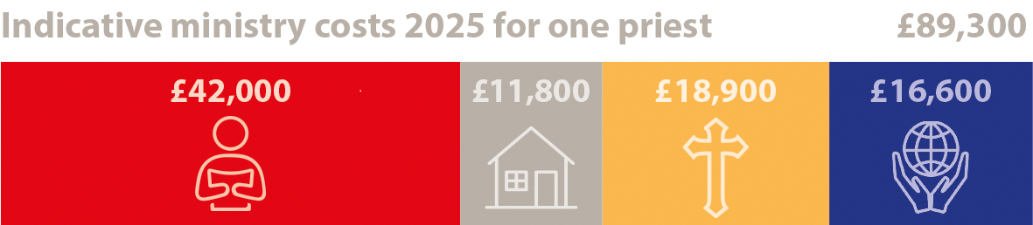
Understanding our shared costs of ministry
The indicative costs of ministry for supporting one priest in a parish are £89,300 for 2025. The Diocesan team have sought to carefully control the budget and support costs
This is a rise of 3.5% or £3,000 from 2024
Please help us maintain parish resourcing by trying to fund the 3.5% cost rise of your ministry costs
Christ Centred | Outward Focused

Slide 5

Clergy stipends, NI and pensions
Supporting over 500 clergy based primarily in parishes, of which over 360 are stipendiary.
Stipends, NI and pension costs total £42,000 per priest for 2025, 47% of our ministry costs
Stipends include a provisional 4% stipend rise for 2025 plus 1% additional increase awarded in April 2024 using the opportunity of reduced pension contributions
Christ Centred | Outward Focused

Slide 6
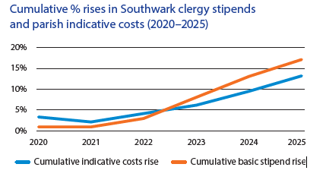
“Our first priority has been to increase Clergy stipends, which have fallen behind inflation” (Bishop Christopher, PSF 2025)
Clergy stipends in Southwark Diocese have risen more than our parish indicative costs over the last six years 2020 -2025
Christ Centred | Outward Focused

Slide 7

Providing clergy with housing
Property costs include smaller repairs and maintenance, payment of water rates, council tax and insurance on more than 250 clergy properties; plus rental of properties when required
“We face escalating property repair costs, a shortage of skilled labour, councils maximising rises in council tax – all making it more challenging to maintain our parsonages well” (Nicola Thomas, Diocesan Secretary)
Housing costs have risen by 12% year on year and represent 13% of our parish indicative costs of ministry
Christ Centred | Outward Focused

Slide 8

Training and other ministry support
Vocations support, training and development for lay and clergy
20 people ordained Deacon in 2023. Pioneer curacy pathway thriving – more than 20 pioneer curates across three years.
First joint lay ministry service: 9 people licensed and 7 commissioned across 7 different ministries!
Lay training – delivered 33 short courses for
915 people
Christ Centred | Outward Focused

Slide 9

Training and other ministry support
£297,000 in mission grants given to parishes and individuals.
Supporting 100 Fresh Expressions of Church with 20 members of the Greenhouse learning community. 120 participants at Mixed Ecology conference
Mission team including Mission Action Planning, Children’s and Young people team, mission grants to churches and individuals
Fresh Expressions and Pioneering encouraging FxC, Hub and Resourcing churches
Christ Centred | Outward Focused

Slide 10

Wider support for our parishes
170 parish proposals for church buildings recommended. Secured £144,000 for “Buildings for Mission” parish grants.
Includes Safeguarding – parish Disclosure and Barring (DBS) applications, training and casework
Area teams i.e. Archdeacons and their offices
Parish Support such as HR advice, IT, Governance, Finance and Diocesan Advisory Committee (DAC) i.e. Church buildings advice
Grants to Welcare, Board of Education and our contributions to the National Church
Christ Centred | Outward Focused

Slide 11
What the PSF or your pledge does not pay for!
Bishops: the Church Commissioners pay for Diocesan and Area Bishops
Some Diocesan posts are time-limited and are fully or part-funded from grants e.g.8 Diocesan posts have current grant or SDF funding
Specific projects where we have secured funding e.g. Diocesan Investment Programme/Strategic Development Projects/Bubble church
Where costs are covered by the National Church’s grants e.g. contribution to Ordinand training
Property costs for non-parish ministry properties
The Cathedral is responsible for its own costs and makes a pledge to the PSF

Slide 12
“Once again I am requesting much of our parishes – that you would fund our projected increase in indicative costs for 2025 which is 3.5%. My fellow Bishops, including our newly announced Bishop of Woolwich, and I acknowledge that this increase will be challenging for some, but we are hopeful that some parishes will be emboldened to give more out of their abundance.”
(Bishop Christopher)
For 2024 75% of our parishes increased their PSF pledge, with 54% matching or exceeding the rise in indicative costs – thank you.

Slide 13
.
Next steps
Please prayerfully reflect on your pledge and make a generous and realistic offer
Please submit your pledge by 15 September using the online link
“Every £ of your pledge goes towards supporting ministry in parishes, whether yours or your neighbours”

Slide 14
Prayer
Generous God, who loved the world so much that you gave your only Son; we give you thanks for your blessings to us.
Pour your love into our hearts we pray, that we may share all that we have with open-handed generosity.
May we, loving your above all things, support the life and work of God’s church and with humble gratitude receive what others give.
May we cheerfully give of ourselves, our time, our money and our talents, to your service; and with faith , hope and love respond to the challenges we face so that your kingdom may flourish in this Diocese and beyond.
For the sake of Him who loved us, Amen.
Rejoice in our confident hope. Be patient in trouble, and keep on praying. When God’s people are in need, be ready to help them.” (Romans 12 v12-13).loved the ow

